Slide 1
Department of Computer Science and Engineering
Power BI and RapidMiner
Hotel Guest Intelligence and Revenue Optimization System
1
Notes:
Title of the project
CSE Dept., SET-Jain University
1

Slide 2
Overview
Abstract
Problem Statement
Objectives
Social/Environmental Impact
Dataset Description
Data Preprocessing
Model Development
Visualizations (Power BI Dashboard)
Conclusion
*
2 of 12

Slide 3
Abstract
Context: Analysis of hotel booking data to understand customer behavior and trends
Objective: To predict booking cancellations, customer reviews, and segment guests
Methods/approach:
• Random Forest (Cancellation Prediction) • Decision Tree & Naive Bayes (Review Prediction) • K-Means Clustering (Guest Segmentation)
Results : Achieved 75.46% accuracy in cancellation prediction and 86.52% in review prediction with meaningful customer segments
Conclusion :Enables data-driven decision making for improving customer satisfaction and reducing cancellations
To analyze and visualize key performance metrics

Slide 4
Problem Statement
➤ Hotels face high uncertainty due to frequent booking cancellations, affecting revenue and planning
➤ It is difficult to identify which customers are likely to cancel in advance
➤ Hotels lack insights into customer satisfaction and cannot predict negative reviews early
➤ There is no clear segmentation of customers for targeted marketing strategies
➤ Manual analysis of large booking datasets is time-consuming and inefficient
➤ There is a need for a data-driven system to predict customer behavior and improve decision-making

Slide 5
Objectives
➤ To analyze hotel booking data and understand customer behavior
➤ To predict booking cancellations using Random Forest model
➤ To predict customer review outcomes using Decision Tree and Naive Bayes
➤ To segment customers into meaningful groups using K-Means Clustering
➤ To perform data preprocessing and feature engineering for improved model performance
➤ To visualize insights using interactive dashboards in Power BI
➤ To enable data-driven decision making for hotels

Slide 6
Social/Environmental Impact
➤ Helps hotels reduce unnecessary cancellations, leading to better resource planning and reduced operational waste
➤ Improves customer satisfaction by predicting and addressing negative experiences in advance
➤ Enables efficient use of hotel resources like rooms, staff, and services
➤ Supports targeted marketing, reducing unnecessary promotions and communication overload
➤ Encourages data-driven decision making in the hospitality industry
➤ Indirectly contributes to sustainability by minimizing overbooking, food waste, and energy wastage

Slide 7
Dataset Description
➤ Dataset: Hotel Booking Dataset
➤ Source: Public dataset obtained from Kaggle, containing real-world hotel booking records
➤ Duration Covered: 2015 to 2017
➤ Dataset Size: • 119,390 booking records • 32 attributes describing each booking
➤ Data Structure: Structured tabular data consisting of numerical and categorical features
➤ Key Attributes Include: • Lead Time – Days between booking and arrival • ADR (Average Daily Rate) – Cost per night • Guest Details – Adults, children, babies • Market Segment – Booking source (online, offline, etc.) • Deposit Type – Payment condition • Special Requests – Customer requirements • Cancellation Status – Indicates if booking was cancelled
➤ Data Preprocessing: Handled missing values and performed feature engineering to enhance model performance

Slide 8
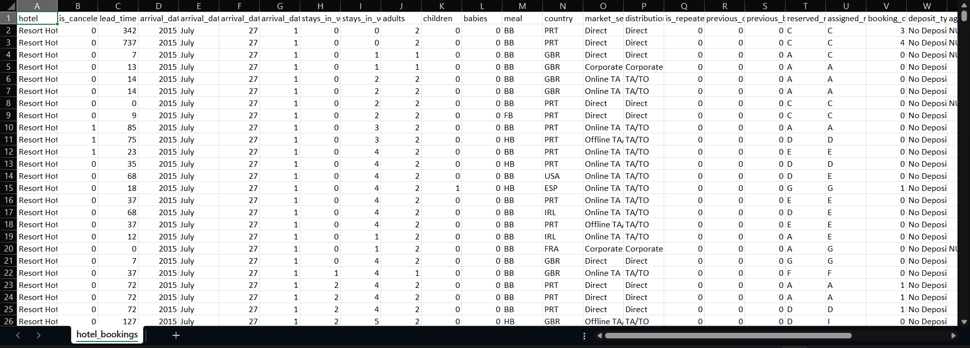
Dataset Description

Slide 9
Data Preprocessing
➤ Data Cleaning: Handled missing values (e.g., replaced null values in children with 0)
➤ Feature Selection: Selected relevant attributes and removed unnecessary columns
➤ Feature Engineering: Created new variables such as: • total_nights • total_spend • group_size • group_type • travel_style
➤ Data Transformation: Converted categorical data into meaningful labels (e.g., Yes/No, Positive/Negative)
➤ Outlier Removal: Filtered extreme values (e.g., very high price or long stays) to improve model accuracy
➤ Normalization: Applied Z-score normalization to scale numerical features for clustering
➤ Data Splitting: Divided dataset into 70% training and 30% testing

Slide 10
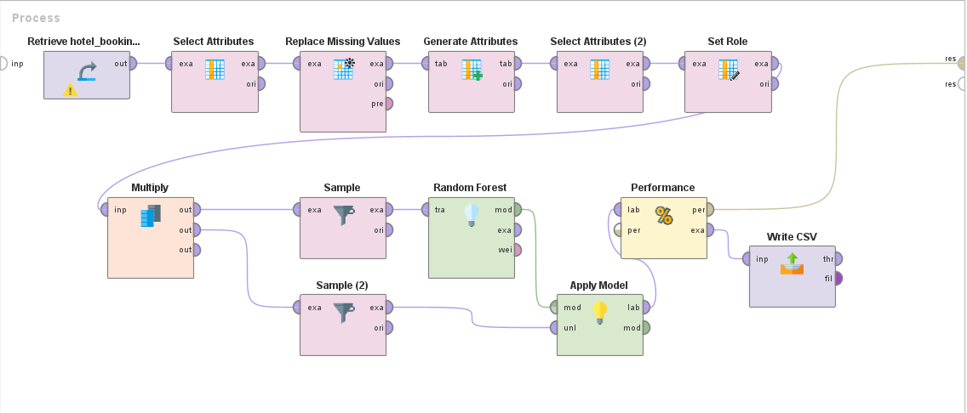
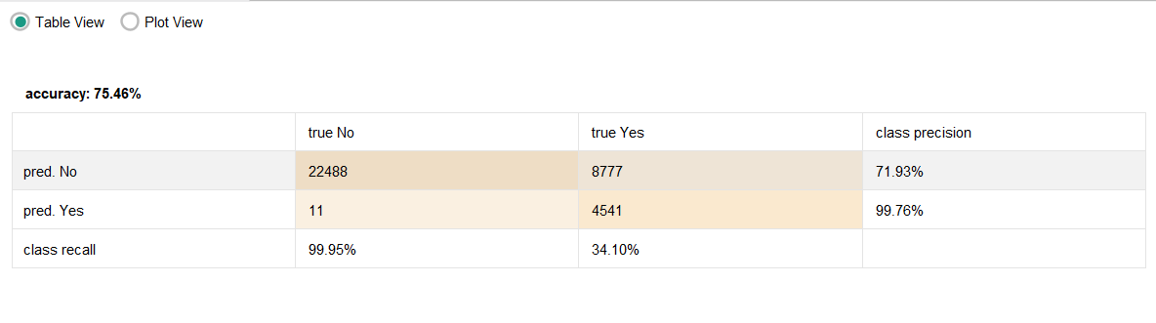
Data Flow Model

Slide 11
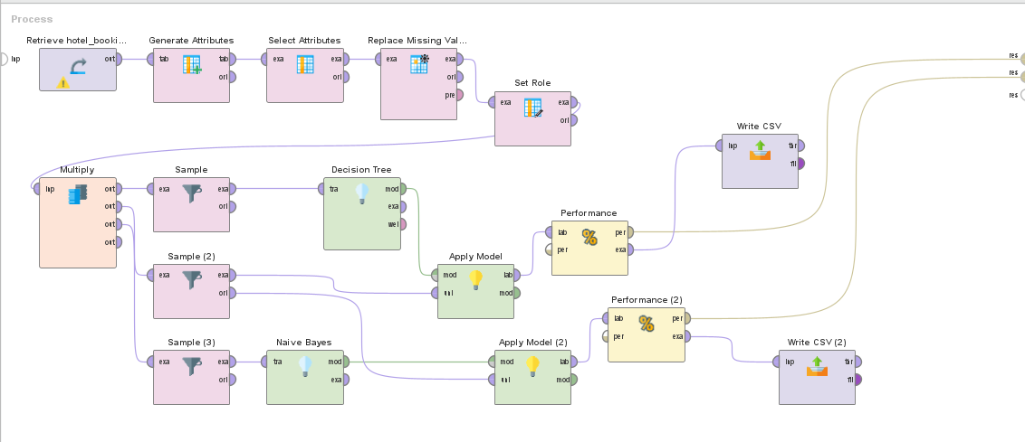
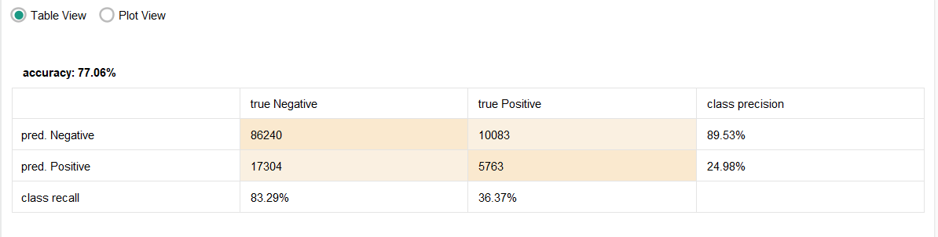
Data Flow Model

Slide 12
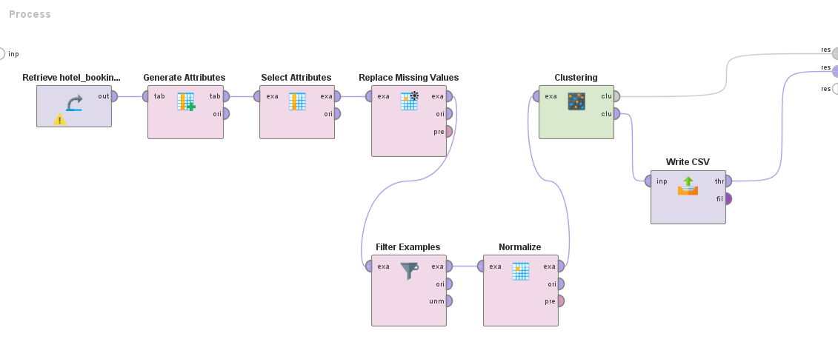
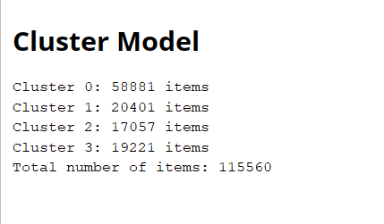
Data Flow Model

Slide 13
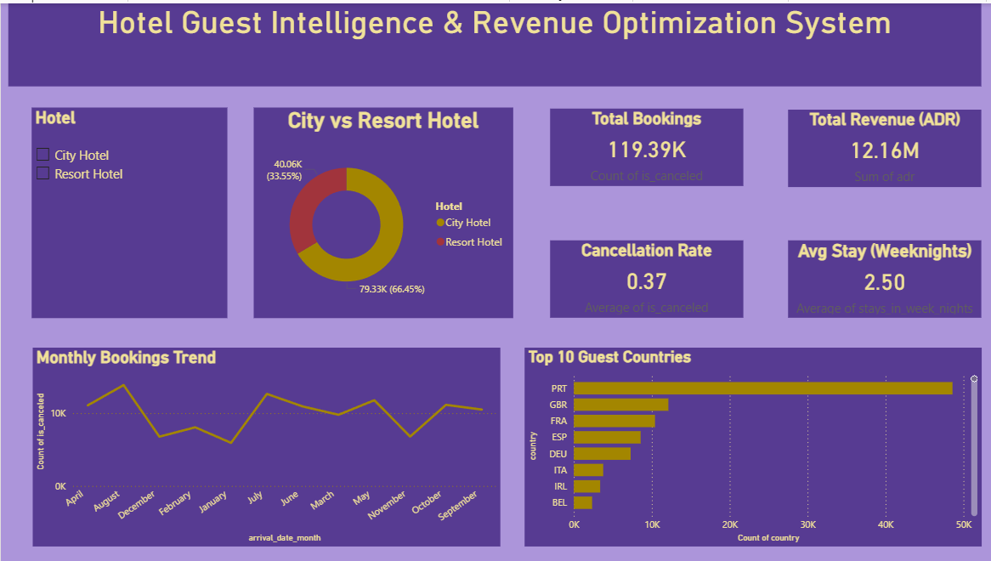
Interactive Visualizations

Slide 14
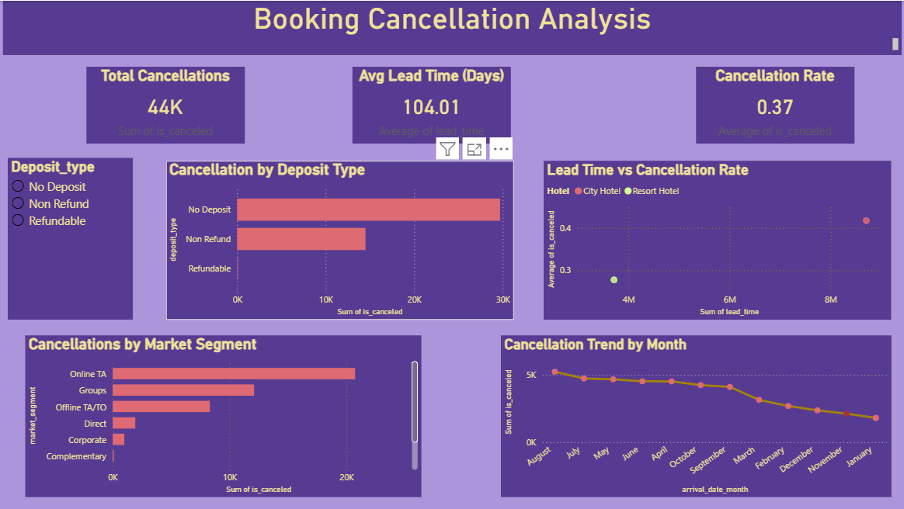
Interactive Visualizations

Slide 15
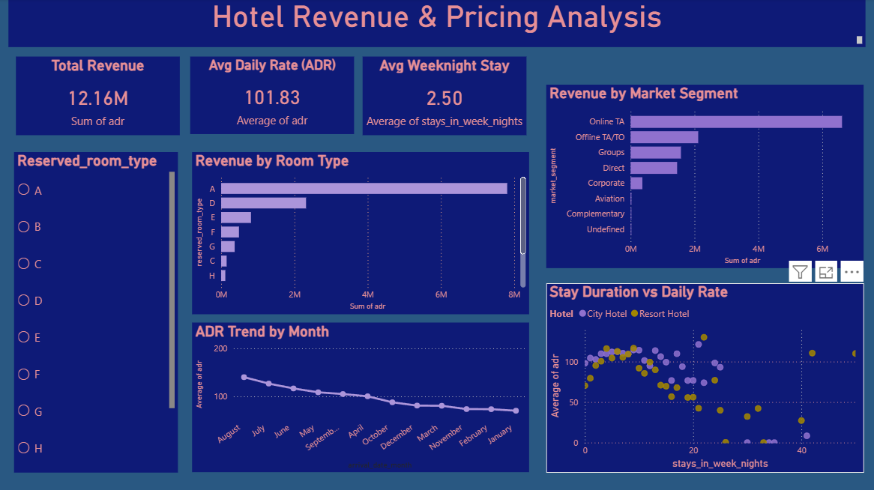
Interactive Visualizations

Slide 16
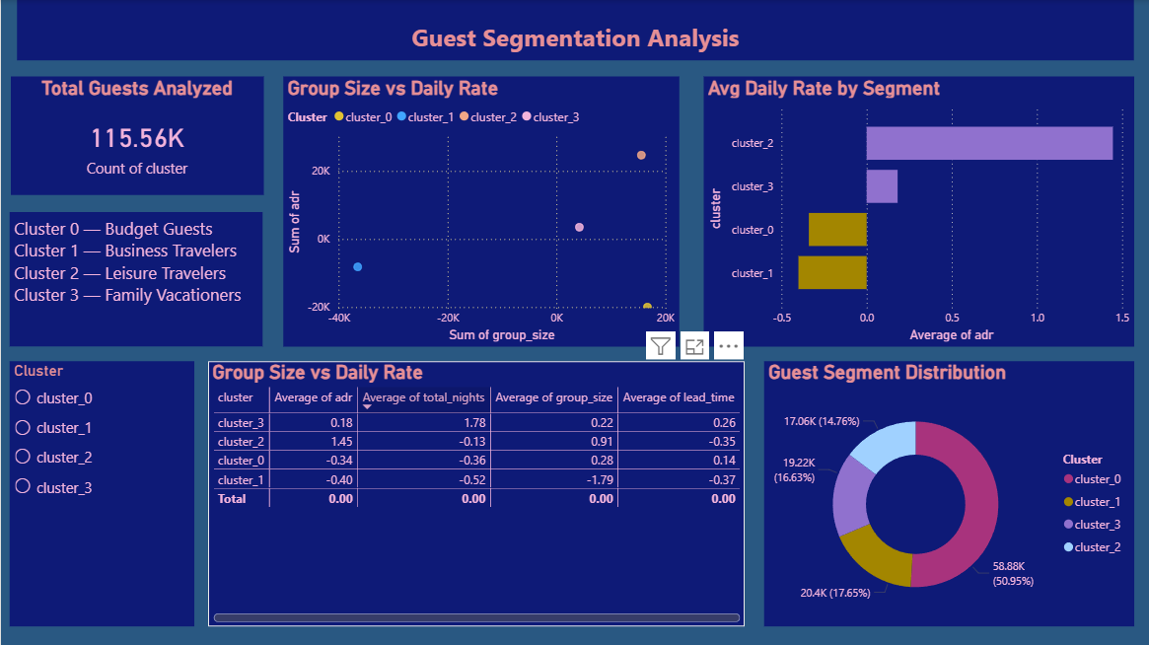
Interactive Visualizations

Slide 17

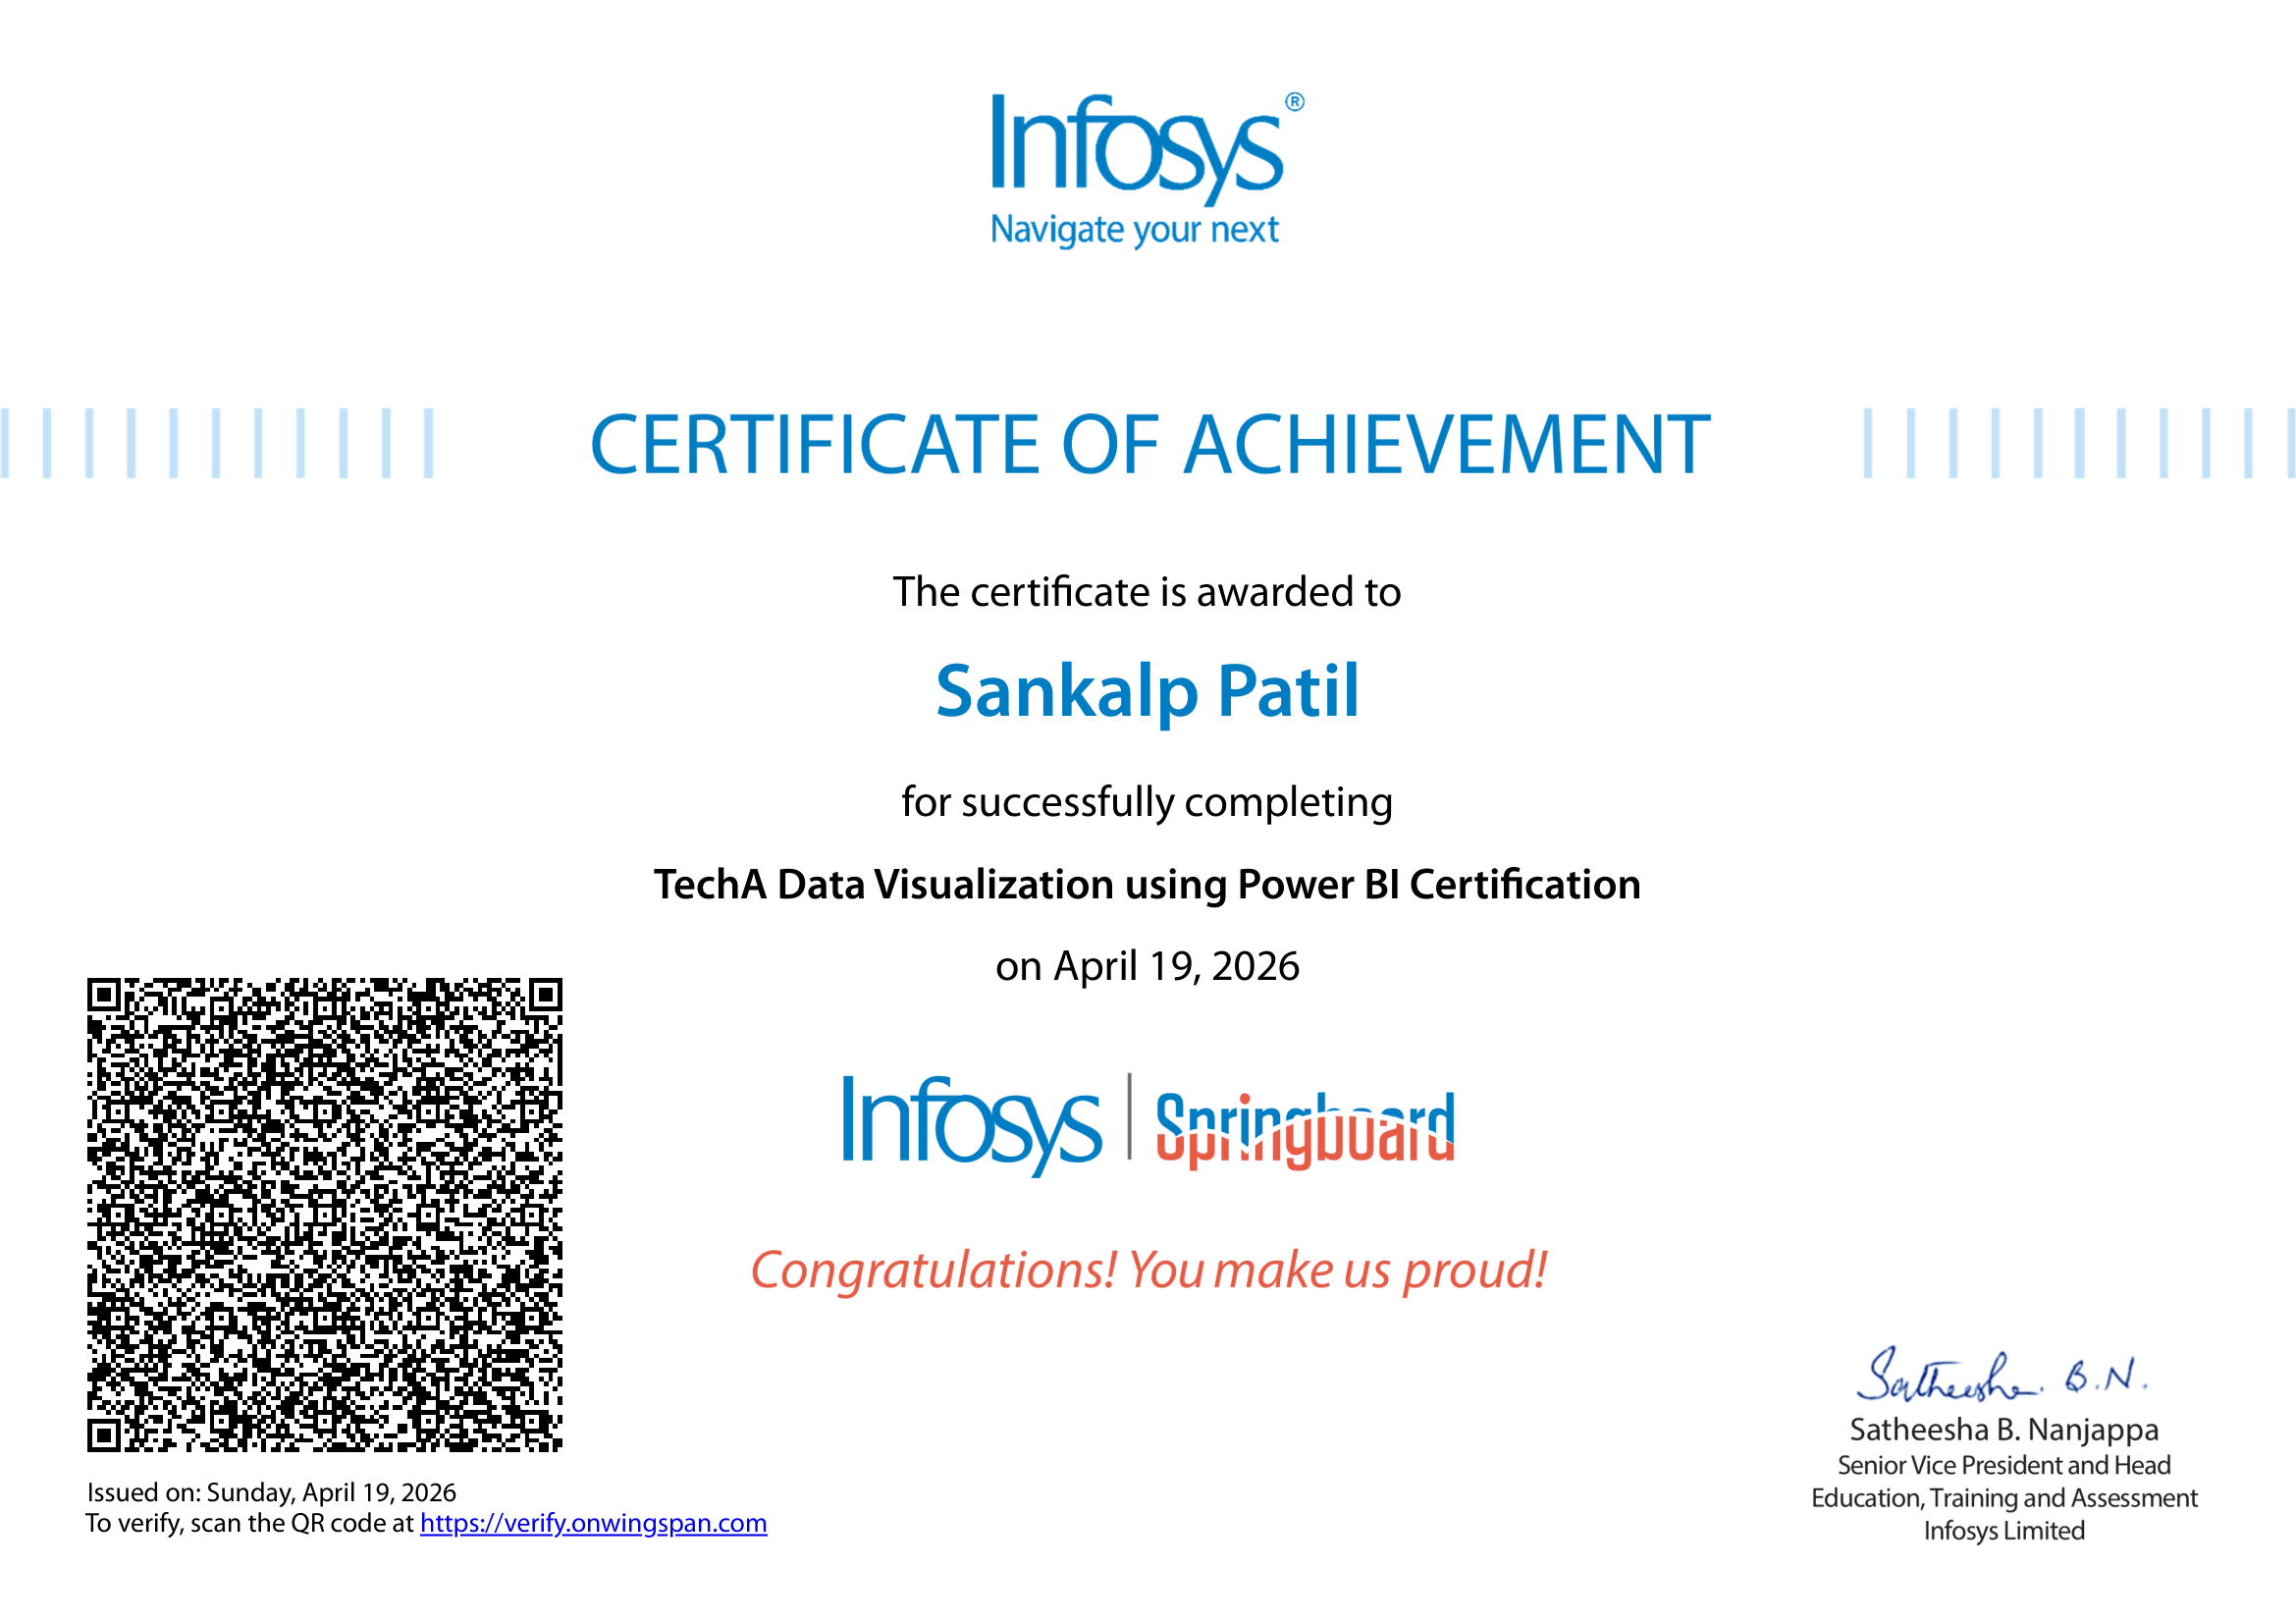
Status of certificate
.

Slide 18
Conclusion
➤ Successfully analyzed hotel booking data to understand customer behavior and booking patterns
➤ Developed predictive models for booking cancellations and customer reviews using Machine Learning techniques
➤ Achieved 75.46% accuracy in cancellation prediction and 86.52% accuracy in review prediction
➤ Identified meaningful customer segments using K-Means Clustering for better targeting
➤ Performed effective data preprocessing and feature engineering to improve model performance
➤ Visualized insights using Power BI dashboards for easy interpretation
➤ The project enables data-driven decision making to reduce cancellations, improve customer satisfaction, and optimize hotel operations

Slide 19


